Slide 1
GRASSHOPPER BEAM ENGINE
Name
American University Of The Middle East
College of Engineering and Technology Mechanical Engineering
Professors name
Academic Year: 2020 – 2021
Date

Slide 2
Introduction
There are many types of steam engines, including the radiating engine which used to drive water pumps where the thermal energy in the steam is converted to a kinetic energy.
This thermal energy is developed to apply coal fuel boilers in which steam is produced through which steam is then pumped.
As the piston rises, the beam moves and the pump rod lower, cold water is injected into. the cylinder to produce condensed water, and finally, a vacuum is formed, which pushes the piston down and raises the pump rod again in each cycle
In this model the beam is pivoted at one end, rather than the center of mechanism. The beam provided negligible mechanical benefit and looks to be used in place of a crosshead because it was effectively a connecting rod return engine

Slide 3
Cont.
The advantage of this engine is that the working end of the beam can be connected directly to the piston rod of the engine, and in this way the engine is made much more compact, especially in terms of height, since the space that the usual swing arm connections between the beam take up and the cross-beam of the Piston rod.
This was generally made in the form of a rectangular frame fused with a lattice or crossed struts.
Despite the weight of the Grasshopper beam is completely unbalanced, it is much lighter than the ordinary beams enable engines of this type to operate fairly satisfactory at higher speeds than the previous type
. The compactness of the entire engine structure provided inherent rigidity as well as simplified assembly and installation using cuboid or brick.
However, the engines were often sunk or raised in the floor to make room for an air pump and condenser under the bed and a race was made available to make room for the steering wheel.

Slide 4
Components’ Design
The crankshaft
Crankshaft is a mechanism of arms or levers to impart reciprocating motion to a rotating shaft. One end of the crank is attached to the shaft and the other end receives reciprocating motion from the hand, crank, etc.
The Shaft connects a lever to a crank or crankshaft in a steam beam engine. Together with the crank, it forms a simple mechanism that converts the reciprocating motion rotary motion into a rotary motion.
A connecting rod can also convert a reciprocating motion into a rotary motion.
The beam
The beam is the main part of the engine that connects all the parts of the engine together. It’s obvious why this type of engine is called beam engine.
During the reciprocating movement of the piston cylinder, the beam transfers the movement to the rest parts of the engine.
In this type of engine, the beam is pivoted at one end, rather than the center of mechanism which leads to a longer stroke of the piston and a greater output of force.

Slide 5
Cont.
Crosshead
It moves between guides between the middle of the beam and the engine body which prevents the piston rod from getting bent due to excessive mechanical loads.
Moving leg
This part is connected between the beam and the engine base, it is connected to the beam at its fulcrum where it’s rotated.
3.6. Cylinder and piston
It is made of cast brass and is bolted to the frame at one end. In the case of small engines, it is integrated into the frame. It forms a chamber in which the piston moves back and forward due to the action of steam.
One end of the cylinder is closed by the center of a separate cap and the end is known as the cylinder cap end. The other end, known as the crankshaft end, carries the stuffing box through which the piston rod passes.

Slide 6
Cont.
The piston is made of Stainless Steel. Force is transmitted due to the pressure of the steam that acts on the crosshead through the piston
The piston rod runs through the cylinder head. Prevents steam from escaping from the cylinder into the atmosphere

Slide 7
Material selection
Mild steel is the least expensive of all steels and the most widely used steel
. Mild steel is used in almost all types of steel products and it is wieldable, very hard and, although it rusts easily, very durable.
It contains less than 2 % carbon. Mild steel can be magnetized and used in most projects that require a large amount of metal. The material used for the base and crank shaft is steel is mild steel.
Stainless steel
Stainless steel has many desirable properties because of its chromium content, it is extremely resistant to corrosion, high strength and durability, its high and low temperature resistance, increased formability and easy fabrication

Slide 8
Manufacturing procedure
Casting
The casting process uses a wide range of metals, as it is an easy, simple and inexpensive method.
Casting operations vary and there are some that are used for a one-time mold, and some of them are multi-use molds due to the quantity required for manufacturing.
The casting process is based on converting the metal to a liquid state by raising its temperature to the melting temperature, and then this liquid becomes in molds that have been designed in a hollow form in the form of the piece to be manufactured and then the lefave molten metal in it until its temperature decreases and this molten metal turns into a solid piece of metal
. Thus, the parts to be manufactured are obtained. This process is good for minerals that have a low melting point.

Slide 9
Cont.
Milling Machine
This process is used to shape metal parts. By means of the grinding machine in this machine, the metal piece is fixed.
Then the cutter moves at different angles to form the piece on the desired shape. In this machine, the metal piece moves up and down, and the cutter moves left and right, back and forward.
This process is also used to remove excess parts and result from the casting.
Drilling process
This process is used to make holes in the metal pieces by means of the drill machine, and it is done by the drill that rotates and presses the metal pieces and that also presses this drill on the pieces and requires high pressure.

Slide 10
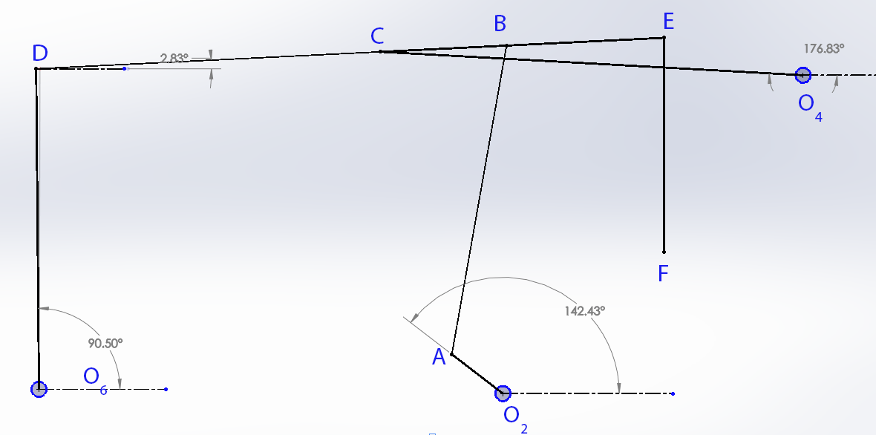
Kinematic analysis
In this part we will show displacement analysis, velocity analysis, and acceleration analysis for this mechanism by graphical method.
Displacement analysis
General position

Slide 11
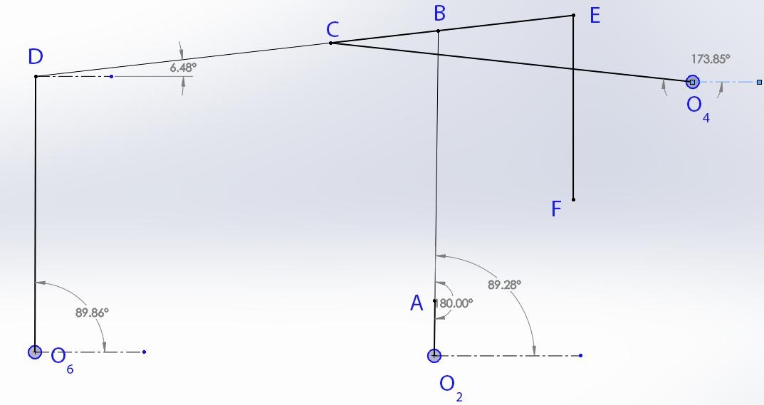
Cont.
First critical position

Slide 12
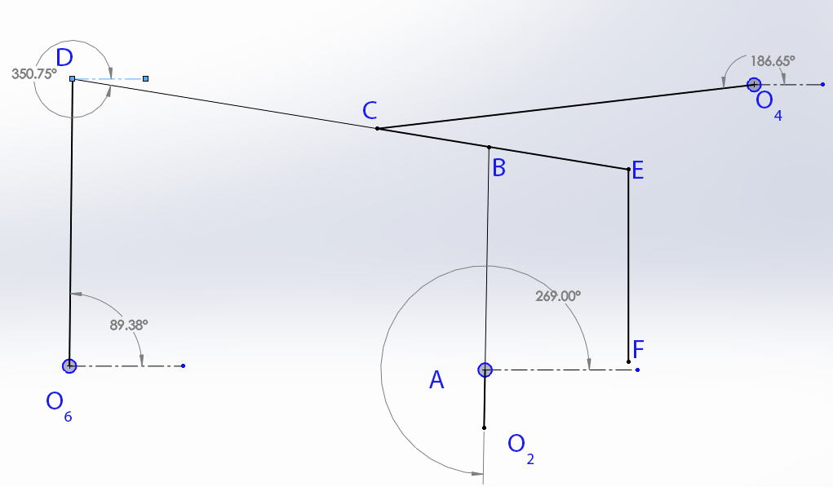
Cont.
Second critical position

Slide 13
Cont.
Displacement in links
link | displacement
OA | 180° CW
OC | 12.8° CCW
OD | 0.5° CCW
DE | 15.73° CW
FF' | 90 cm

Slide 14
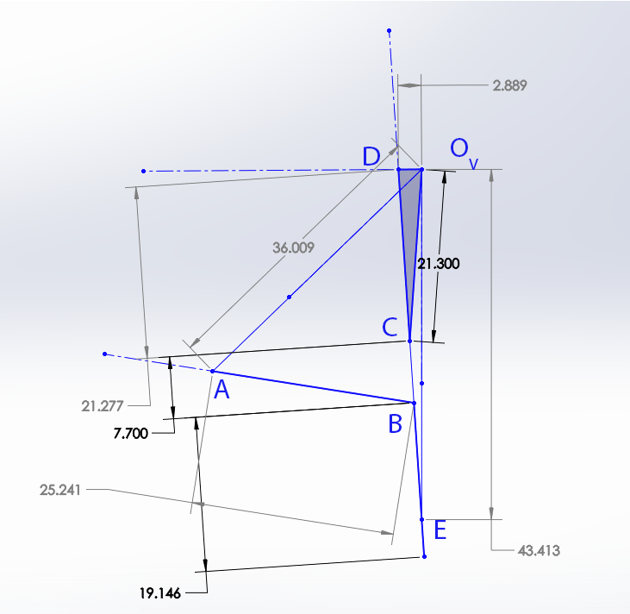

Cont.
Velocity analysis
Assume $ω_{OC}=1\frac{rad}{s}$
$V=ωR=1∗213=213\frac{cm}{s}$

Slide 15
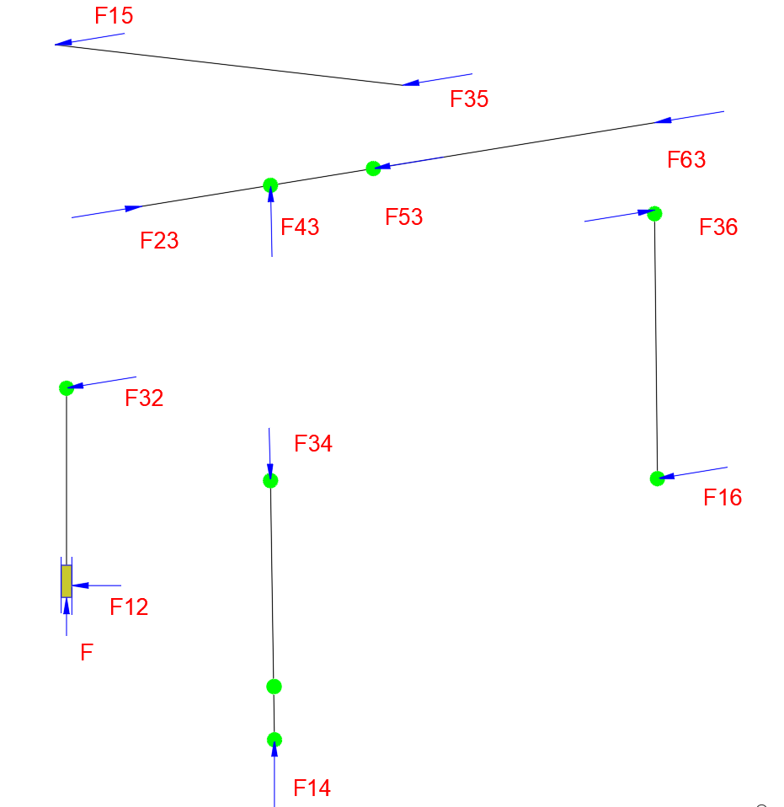
Kinematic analysis
Kinetic analysis

Slide 16

Cont.
$F=150 KN$
For link 2
$\sum{F=0}$
$F+F_{12}+F_{32}=0$
$Fj+F_{12}i−F_{32}\cos{12 i}−F_{32}\sin{12}j=0$
For $i$
$F_{12}−F_{32}\cos{12 }=0$
For $j$
$F=F_{32}\sin{12}$
$150=F_{32}\sin{12}$

Slide 17

Cont.
$F_{32}=721 KN$
$F_{12}=705 KN$
For link 3
$\sum{F=0}$
$F_{43}=F_{23}=−F_{32}=−721 KN$
$F_{63}=721 KN$
$F_{53}=721 KN$
For link 4
$\sum{F=0}$
$F_{14}=F_{14}={−F}_{43}=−721 KN$

Slide 18

Cont.
For link 5
$\sum{F=0}$
$F_{15}=F_{35}={−F}_{53}=−721 KN$
For link 6
$\sum{F=0}$
$F_{16}=F_{36}={−F}_{63}=−721 KN$

Slide 19
Conclusion
We have done a study on this device and know its parts, how it works and the movement that each part performs in it, in order to convert the reciprocating movement resulting from the pressure of the steam into a rotational burning that is used.
A study was conducted to find out the best materials that are used in the manufacture of those parts and the industrial processes that are used, and an analysis of displacement, velocity and acceleration was made.

Slide 20
References
Frenken, K. (2004). The early development of the steam engine: an evolutionary interpretation using complexity theory. Industrial And Corporate Change, 13(2), 419-450. doi: 10.1093/icc/dth017
Thurston, R. (1899). THEORY OF THE STEAM ENGINE. Science, 9(227), 659-659. doi: 10.1126/science.9.227.659
A model single cylinder Grasshopper beam engine,. (2018). Retrieved 23 April 2021, from https://www.christies.com/en/lot/lot-769604
Polly Model Engineering: Stationary Engine Kits - Anthony Mount Models. (2021). Retrieved 23 April 2021, from https://www.pollymodelengineering.co.uk/sections/stationary-engines/anthony-mount-models/easton-Andersons-Grasshopper-Beam-Engine.asp

